Slide 1
Git, GitHub
Nguyễn Thị Diễm

Slide 2
I. Introduction Git, GitHub II. Why use Git in the project III. Basic Git Commands IV. Task Management in Git
GIT, GITHUB

Slide 3
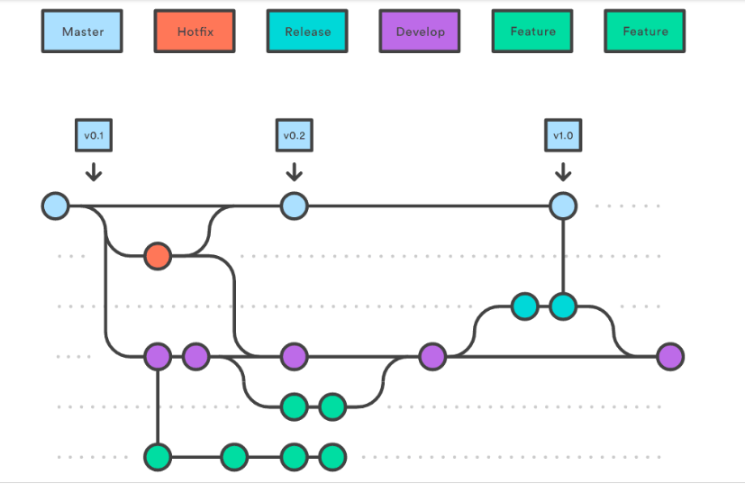
I. Introduction
1. Git Flow

Slide 4
I. Introduction
1. Definition in Git
Git Flowđ
Check out
Repositoryđ
Pull Request
Branch
Merge
Local repositoryđ
Release
Commit
Remote repository

Slide 5
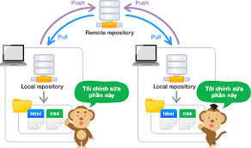
I. Introduction
3. Repostory

Slide 6

II. Why use Git, GitHub
Be easy code management
Track changes to versions
Make your CV more beautiful

Slide 7
III. Basic Git Commands
Git config
Configure name and email
Name: git config –global user.name “name”
Email: git config –global email.name “email”
b. Check configuration name and email
Check: git config --list

Slide 8
III. Basic Git Commands
2. Git init: git init
3. Git clone: git clone [url_repository]
4. Git status: git status
5. Git branch: git branch, git branch –a
6. Git checkout: git checkout [name_branch], git checkout –b [name_branch]
7. Git add: git add [file_name], git add *, git add .

Slide 9
III. Basic Git Commands
8. Git commit: git commit –m “…”
9. Git push/pull: git push origin [name_branch],
git pull origin [name_branch]
10. Git merge: git merge [name_branch]
11. Git log: git log, git reflog
12. Change branch name: git branch –m [new_name]->git push origin --delete [old_name]-> git push origin [old_name] [new_name]->git push origin –u [new_name]

Slide 10
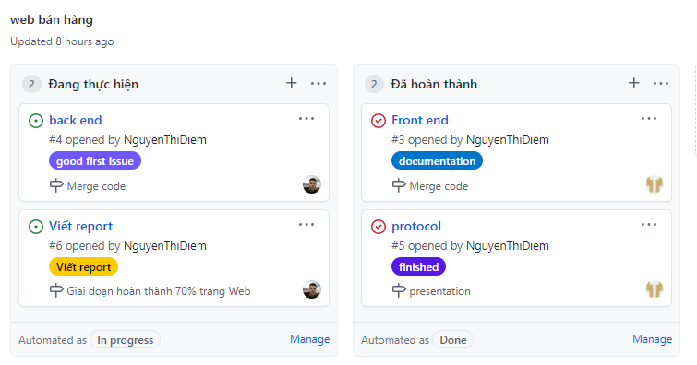
IV. Task Management in Git

Slide 11


